Slide 1
Canadian Medicinal Plant Detection using Convolutional Neural Network with Transfer Learning
Presented by:
Shaon Bhatta Shuvo
Akram Vasighizaker
Maryam Mahdavirad
Akshay Shah
Malita Dodti

Slide 2
Outline
Motivation
Problem Statement
Benefits of Medicinal Plants
Literature Review
Architecture
Dataset
Methodology
Result
Conclusion
References

Slide 3
Motivation
Medicinal plant species classification is crucial for medicine production and conservation.
Peoples are not aware of their rural and urban medicinal plants and their uses.

Slide 4
Problem Definition
Task 1:
Detect a Canadian medicinal plant image using Convolutional Neural Network
Task 2:
Creating a high accuracy image classification model

Slide 5
Benefits of Medicinal Plants
Medicinal plants have been utilized in curing human diseases for thousands of centuries and are the source of a significant percentage of medicines.
Canadian medicinal plants have a prolonged history of consumption with hundreds of classes being employed by First Nations Canadians in their old-style medicine.

Slide 6
Selected Literature Review
author(s), year | their research
Woebbecke et al., 1995 Gerhards & Christensen, 2003 | The initial approaches on these problems used the plant color information.
Agarwal et al., 2006; Neto et al., 2006 | Some leaf-based studies also used the shape information.
Sack et al., 2008 Scoffoni et al., 2011 | Some studies utilized the vein morphology.
Husin et al., 2012 | Several studies combined the shape and texture information extracted from the leaf.
Larese et al., 2014 | A method is proposed in which computer vision techniques are used to extract the morphological leaf vein features.
Notes:
The use of deep learning algorithms in machine vision problems is becoming more and more popular. The plant and the leaf identification have been previously studied with different techniques by various researchers.

Slide 7
Selected Literature Review- Cont.
author(s), year | their research
Grinblat et al., 2016 | The use of deep learning in plant and leaf identification is a relatively new approach. A CNN model is proposed to work with leaf veins. Leaf veins are extracted as a binary mask and an end-to-end CNN model is trained with these masks
Barré et al., 2017 | They proposed a CNN architecture for the leaf identification, called LeafNet. They applied the Foliage, LeafSnap, and Flavia datasets and built a CNN model for the classification. An architecture similar to well-known CNN models like AlexNet and CifarNet was proposed in their study.
Jeon and Rhee, 2017 | They used the transfer learning from pre-trained CNN models. Pre-trained GoogleNet was used for the feature extraction. Leaf images in different scales were given to GoogleNet as input and the activation values of different layers were stored as features.
Ji et al. , 2018 | They proposed an innovative 3D CNN-based approach through which the crops can be classified automatically from the remote sensing images given as input.
Saini, Khamparia, and Luhach, 2019 | This study demonstrated that the transfer learning improves the performance of deep learning models.
Notes:
According to the literature survey outlined in this section, there is no study which evaluates the effect of transfer learning scenarios for Canadian medical plant classification models. Hence the work that we present in this project can be considered complementary to the earlier studies.

Slide 8
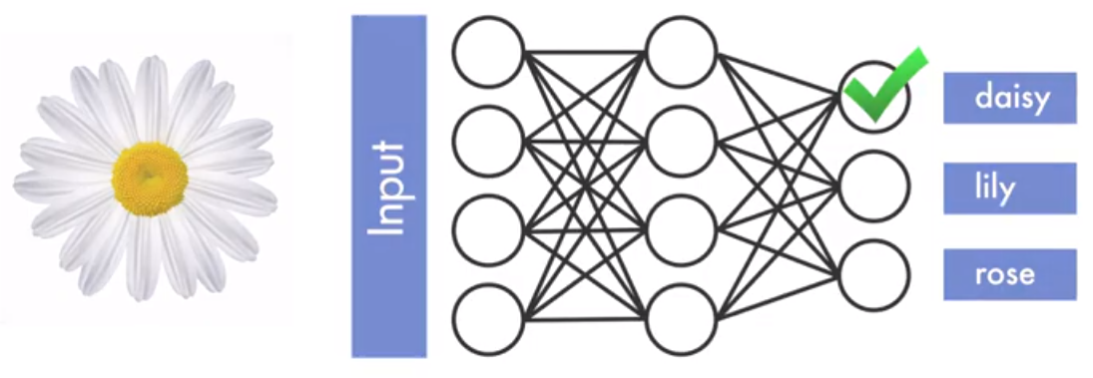
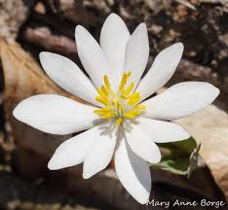
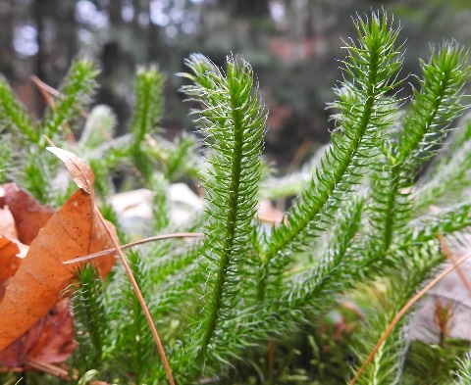
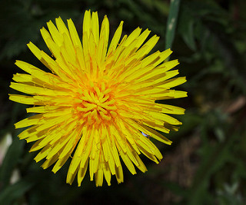
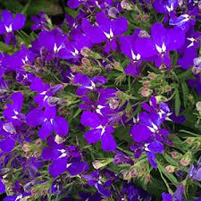
Image Classification
Notes:
Image classification is a problem that a CNN could do…
A trained network that can classify images into one of thousand pre-determined categories.

Slide 9

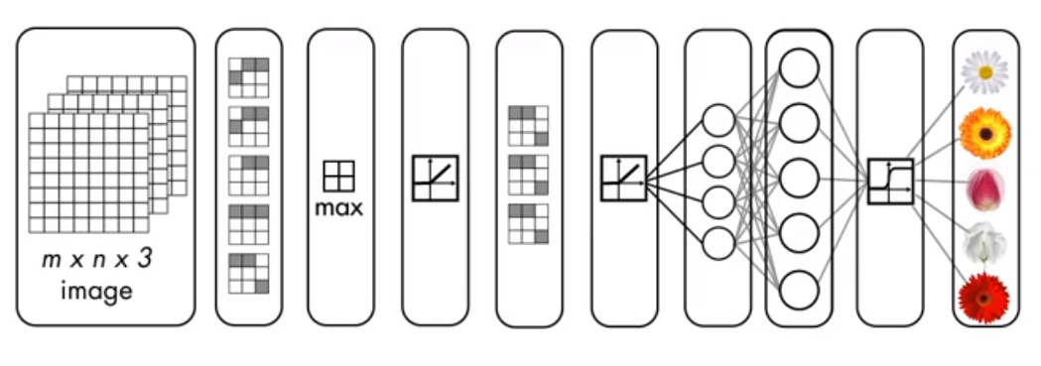
What is CNN?
Notes:
A Convolutional Neural Network or CNN is a network architecture for deep learning.
A CNN is made up of several layers that transform an input to produce an output.
Every hidden layer increases the complexity of the learned image features….
For example, the first hidden layer learns how to detect simple features, like edges, and the last layer learns how to detect more complex shapes.
A CNN model is a combination of two components: feature extraction part and the classification part.

Slide 10
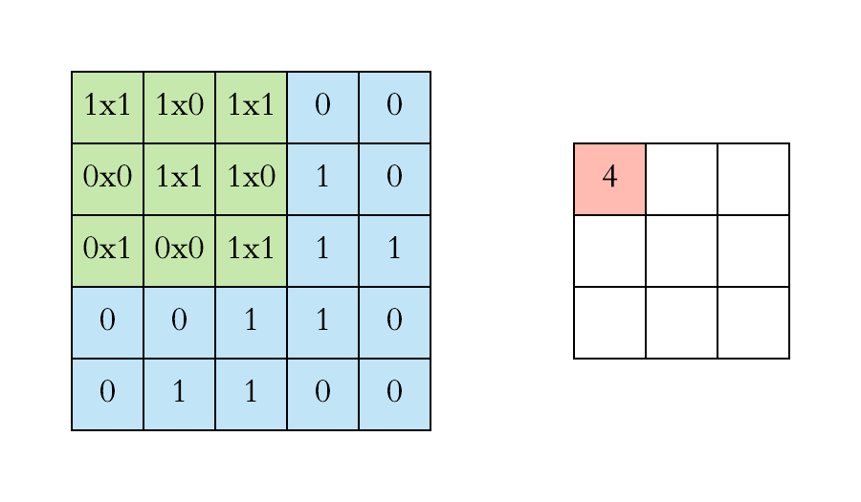
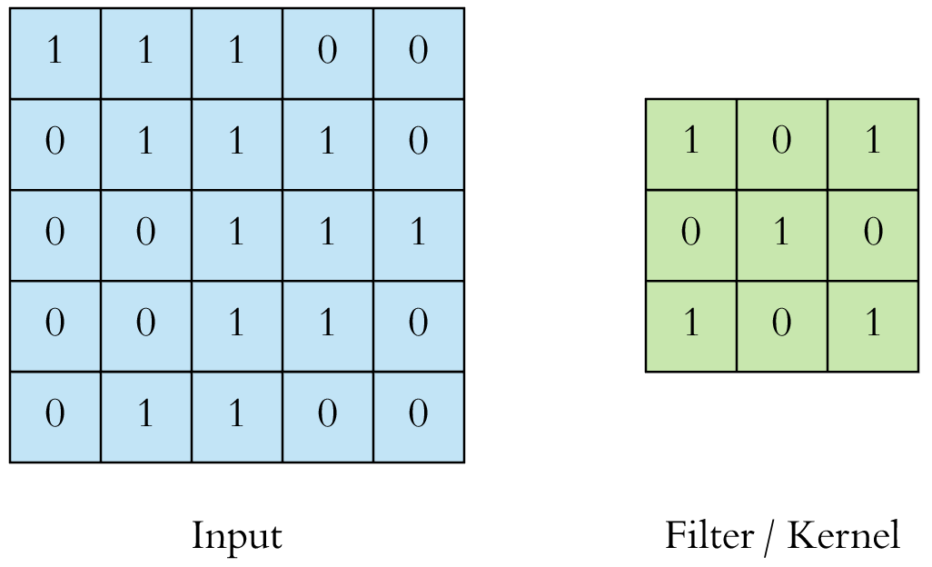
Local Receptive Fields & Feature Map
Local Receptive Fields & Feature Map
Activation Function
Pooling
Fully Connected Layer
Dropout
Transfer Learning
Notes:
In order to understand how CNNs work. We will cover some concepts….
In a Typical neural network Each neuron in the input layer, is connected to a neuron in the hidden layer, however in a CNN only a small region of input layer neurons, connect to neurons in the hidden layer. Theses regions are referred to as Local Receptive fields.
The local Receptive field is translated across an image to create a feature map.
You can use Convolution to implement this process. Convolution is a mathematical operation,
We can perform the convolution operation by sliding a filter over the input.
At every location, we do element-wise matrix multiplication and sum the result.
This sum goes into the feature map, (the red area)

Slide 11
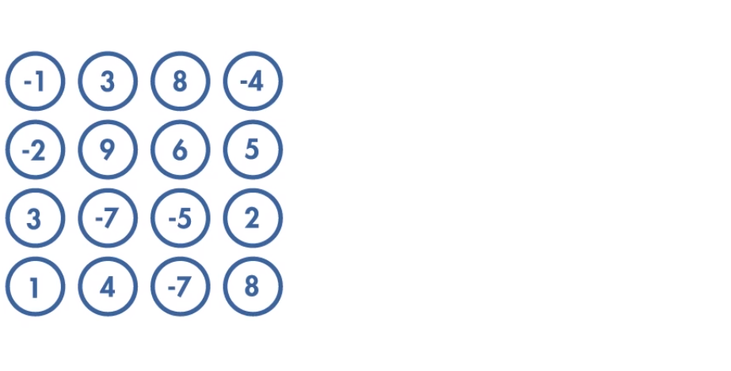
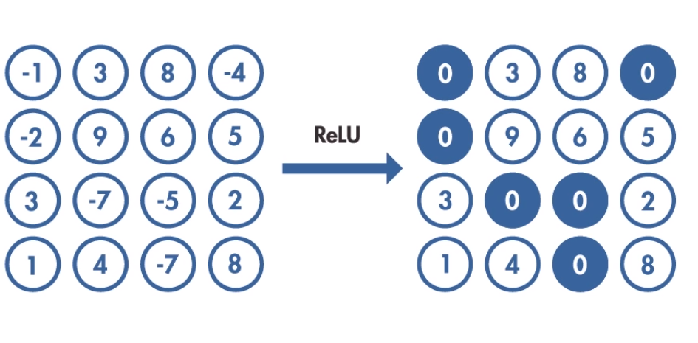
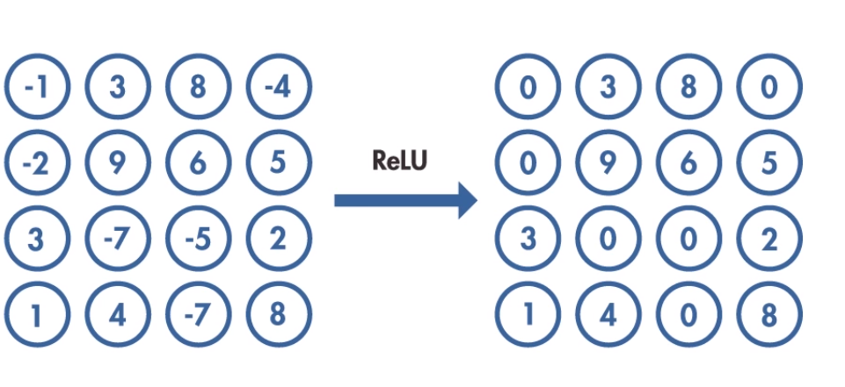
Activation Function
Notes:
The activation step apply the transformation to the output of each neuron, by using activation functions.
Rectified Linear Unit (ReLU) is an example of a commonly used activation function.
It takes the output of a neuron and maps it to the highest positive value, or if the output is negative, the function, maps it to zero.

Slide 12
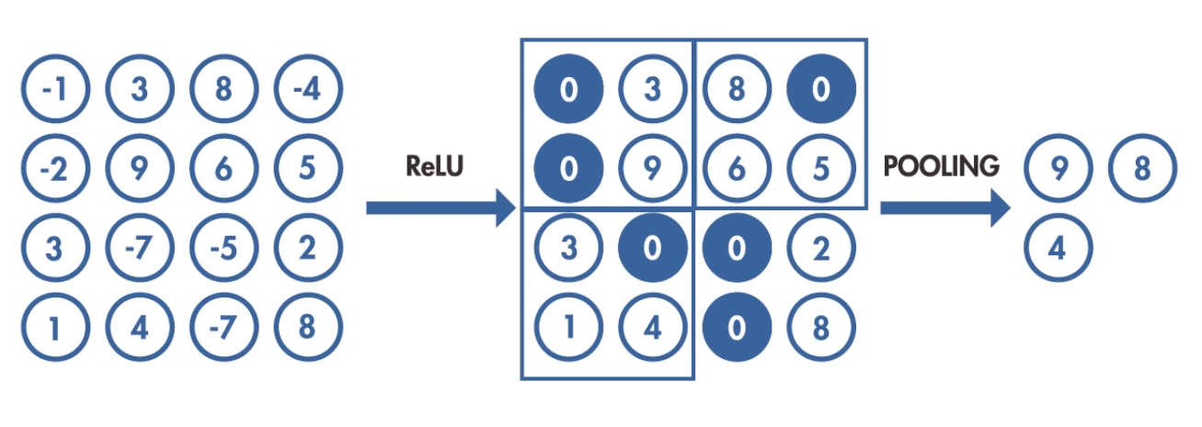
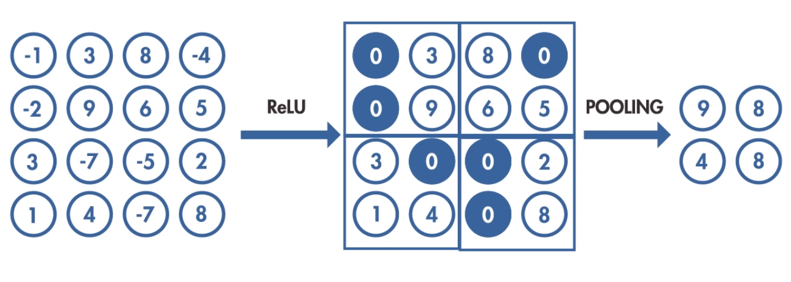
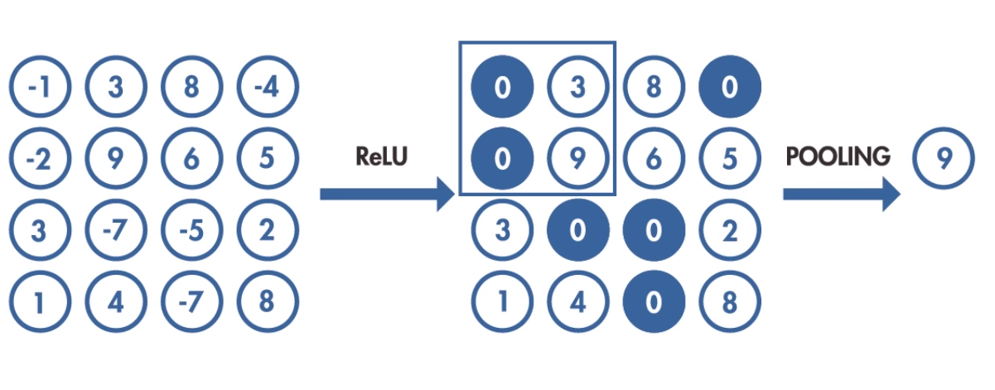
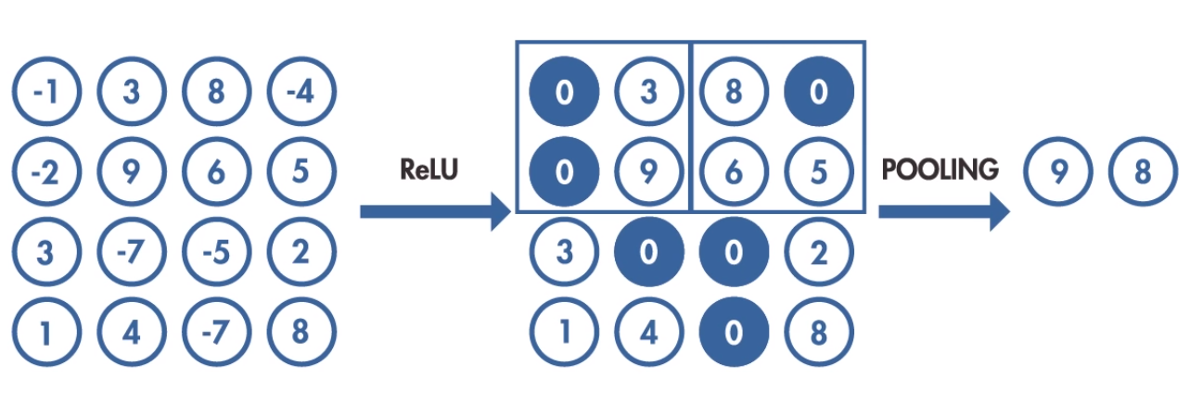
Pooling
Notes:
You can further transform the output of the activation step by applying a pooling step.
Pooling reduces the dimensionality of the features map by condensing the output of small regions of neurons into a single output.
This is the main use case of pooling, downsampling the feature map while keeping the important information.
This reduces the number of parameters that the model needs to learn now.

Slide 13
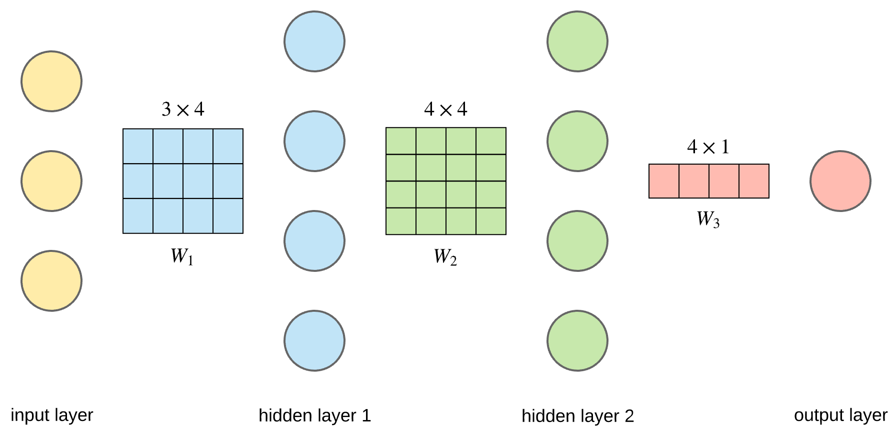
Fully Connected Layer
Notes:
We can flatten the output of the final pooling layer to a 1D vector of numbers.
A fully connected layer between 3 nodes and 4 nodes is just a matrix multiplication of the 1x3 input vector (yellow nodes) with the 3x4 weight matrix W1.
The result of this dot product is a 1x4 vector,( represented as the blue nodes. )
We then multiply this 1x4 vector with a 4x4 matrix W2, resulting in a 1x4 vector, (the green nodes. )
And finally using 4x1 matrix W3 we get the output.

Slide 14
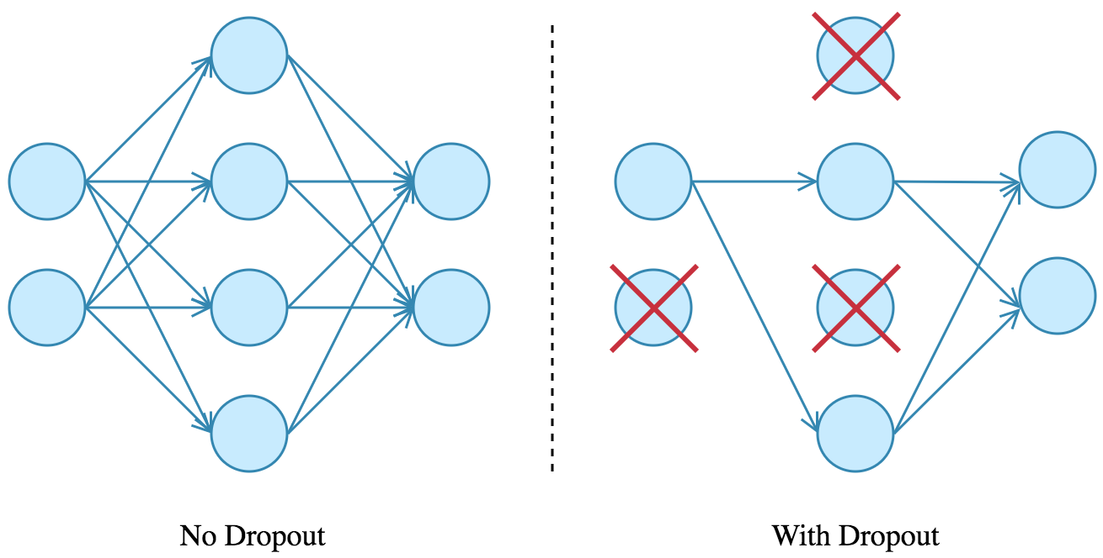
Dropout
Notes:
In order to prevent overfitting, we use Dropout which is the most popular regularization technique for deep neural networks.
The idea is very simple.
During training time, a neuron, and all the inputs and outputs to this neuron is temporarily “dropped” or disabled with probability p.
The hyperparameter p is called the dropout-rate and it’s typically a number around 0.5,
In the absence of a neuron, the other neurons will need to learn, and this expertise needs to be spread out between other neourons.
Dropout can be applied to input or hidden layer nodes but not the output nodes.

Slide 15
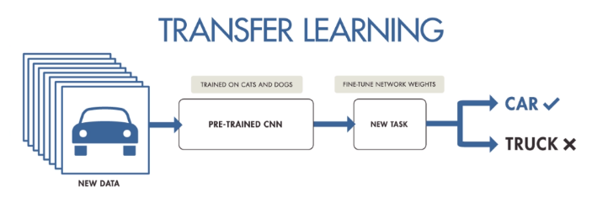
Transfer Learning
BERT
YOLO
GloVe
UnsupervisedMT
Notes:
There is another method,… Transfer Learning, to train a deep NN model using small dataset.
It is base on the idea that you can re-use knowledge of one type of problem to solve a similar problem.
For example, you could use a CNN model that has been trained to recognize animals to train a new model that differentiates between cars and trucks.
Big corporations (companies, universities etc.) tend to release such models to the public, aiming to enhance the development of this field.
Some pre-trained models used directly include BERT as well as YOLO, GloVe, UnsupervisedMT and more.

Slide 16
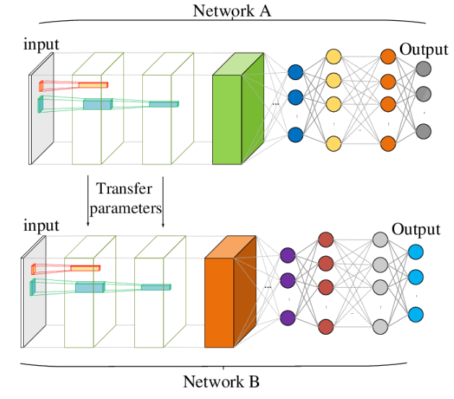
Transfer Learning…
A network
Training data
Algorithm parameters
Notes:
The process that takes a pre-trained network,… re-training it on a new data, and modifying it is called Transfer Learning.

Slide 17
Deep Transfer Learning Strategies
Direct use of pre-trained models
Leveraging feature extraction from pre-trained models
Fine-tuning last layers of pre-trained models
Notes:
And, There are several different strategies for Transfer learning
The simplest strategy is to solve a on a different Target task but in the same Domain by directly using a full or part of an already pre-trained model from a source task.
Or, Instead of using the model, we can treat the pre-trained model as a feature extractor.
This approach allows us to directly apply new dataset to solve an entirely different problem.
Since the pre-trained complex model is used as features for the new task, we are allowed to train a simpler and faster linear model to modify the output based on the new dataset.
This strategy is best when the target task dataset is very small
Finally, We can go one step further, by not only training the output classifier, but also fine-tune weights in some layers of the pre-trained model.
This strategy is best when the target task dataset is significantly big

Slide 18
Data Collection (Background)
Numerous research works were carried out.
features such as shape, texture, color, morphological or physiological features.
In our project Convolutional Neural Network for achieving higher classification of Canadian Medicinal Plant

Slide 19
Data Collection (Background)
Four specious is selected namely Clubmoss, dandelion, lobelia and bloodroot.
Dataset contains 1805 images, includes approximately 400 images for each species.

Slide 20
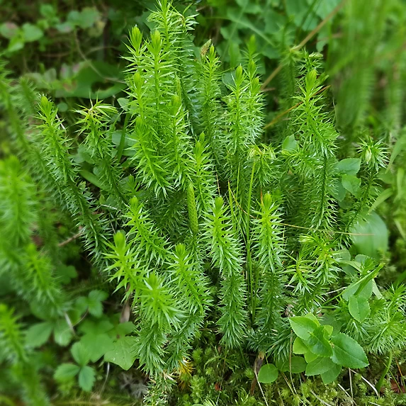
Clubmoss
Clubmoss, Lycopodium clavatum, is native to woodlands across most of the country
Found near Canada’s Waterfall area
The biggest health benefits of clubmoss: treating urinary and kidney disorders

Slide 21
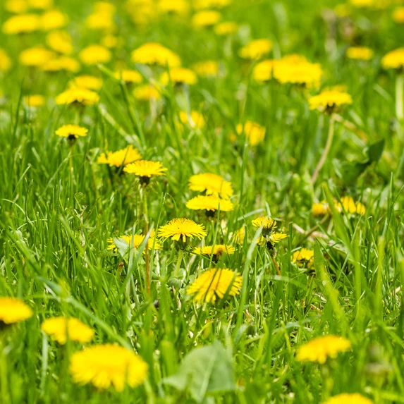
Dandelion
Dandelion, Taraxacum officinale, is native to most of Canada and commonly regarded as a weed
Growing at one of the many amazing Canadian camping spots.
The biggest health benefits of dandelion: treating liver problems, joint complaints, anaemia and skin conditions

Slide 22
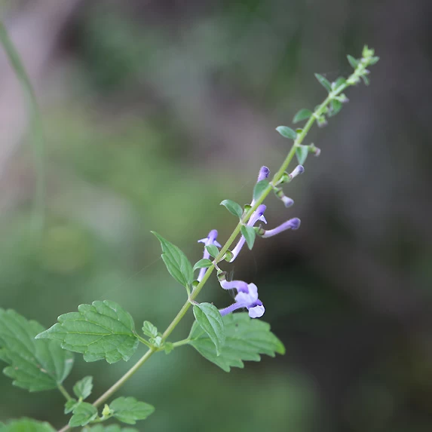
lobelia
Lobelia, Lobelia inflata, is native to New Brunswick, Prince Edward Island, Nova Scotia and the southernmost parts of Quebec and Ontario.
Also known as Indian tobacco
It’s used mainly for treating respiratory ailments like asthma and bronchitis
You can smoke the leaves or brew them into a tea.

Slide 23
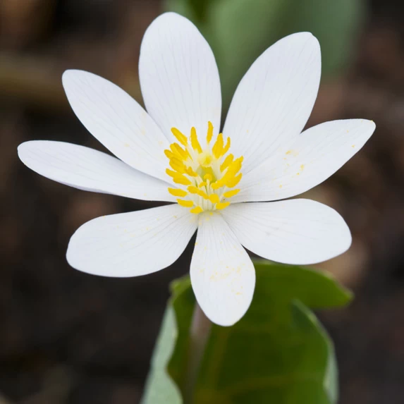
Bloodroot
Bloodroot, Sanguinarea canadensis, is native to the area around the Great Lakes as well as parts of New Brunswick and Nova Scotia.
Used in relieving respiratory ailments and skin problems
Bloodroot is toxic and you should only use minute amounts as prescribed by a qualified healthcare professional.

Slide 24
Steps:
Articulate the problem
Establish data collection mechanisms
Format data to make it consistent
Reduce data
Complete data cleaning

Slide 25
Methodology
Data Preprocessing
Model Implementation
Performance Evaluation

Slide 26
Methodology (Data Preprocessing)
Data Distribution
Data Augmentation
Data Rescaling and Resizing

Slide 27
Data Preprocessing (Data Distribution)
Data
(1805 Images)
Train(~80%)
Bloodroot
Clubmoss
Dandelion
Lobelia
Validation
(~10%)
Bloodroot
Clubmoss
Dandelion
Lobelia
Test(~10%)
Bloodroot
Clubmoss
Dandelion
Lobelia

Slide 28
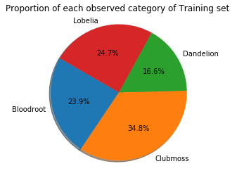
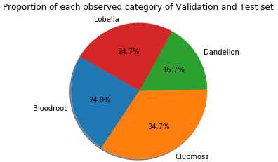
Data Preprocessing (Data Distribution)
Size of each class in Training Set:
Bloodroot : 360 instances.
Clubmoss : 524 instances.
Dandelion : 250 instances.
Lobelia : 371 instances.
Size of each class in Validation Set:
Bloodroot : 36 instances.
Clubmoss : 52 instances.
Dandelion : 25 instances.
Lobelia : 37 instances.
Size of each class in Test Set:
Bloodroot : 36 instances.
Clubmoss : 52 instances.
Dandelion : 25 instances.
Lobelia : 37 instances.

Slide 29
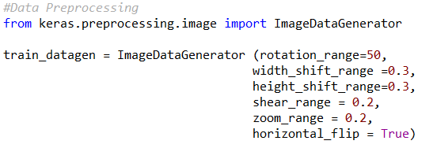
Data Preprocessing (Data Augmentation)
Since we have small amount of dataset, therefore we applied data augmentation technique to generate different shapes of images from the given data. We applied ImageDataGenerator class form keras.preporssing library to our training dataset to obtain augmentation by creating train_datagen object as follows:
rotation_range: (int: 0 to 180 )
a range within which to randomly rotate pictures.
width_shift and height_shift:
ranges (as a fraction of total width or height) within which to randomly translate pictures vertically or horizontally.
shear_range:
for randomly applying shearing transformations.
zoom_range:
for randomly zooming inside pictures.
horizontal_flip:
for randomly flipping half of the images horizontally
--relevant when there are no assumptions of horizontal asymmetry (e.g. real-world pictures).
In summary, augmentation transforms images randomly into different shapes, so that our model would never see twice the exact same picture.
This helps the model generalize better and eventually reduces the chance of overfitting.
Detail documentation about this class available at: https://keras.io/preprocessing/image/

Slide 30
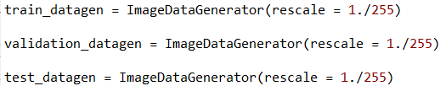
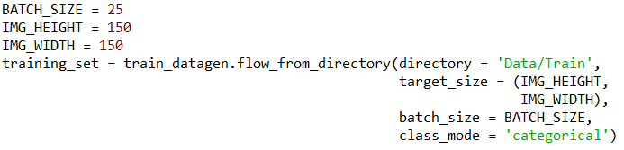
Data Preprocessing (Data Rescaling and Resizing)
Data Rescaling :
All the images are consist of RGB values with pixel range from 0 to 255. However, we need to rescale these values between 0 to 1, because values in range 0 to 255 would be too high for our model to process. Therefore, we used same ImageDataGenerator class to update train_datagen and created two new object validation_datagen and test_datagen from validation and test set respectively as follows:
Data Resizing:
Since we have collected data from different sources of internet. Height and width of every images are not same. However, we need to make each images of same size in terms of height and width for purpose of train, validation and testing. In this case we kept height and width pixels size to 150 to generate the final training_set.
We applied same approach to generate validation_set and test_set using validation_datagen and test_datagen object respectively to resize each images into 150X150 pixels.

Slide 31
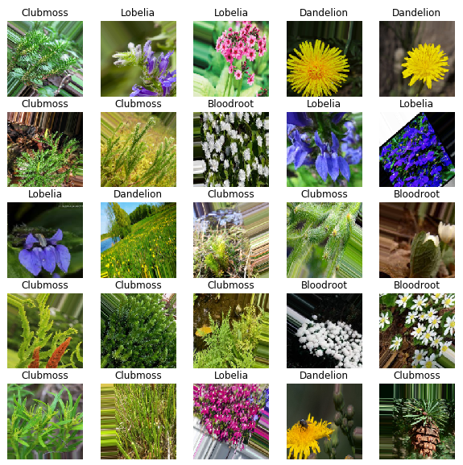
Methodology (Data Preprocessing)
Lets look into a training dataset of a random batch (batch_size =25)

Slide 32
Methodology (Model Implementation)
Model Construction
Model Compilation
Train and Validation

Slide 33
Methodology (Model Implementation)
Before the model can be used to recognize images:
It must be trained on large set of labeled images.
Let’s look into some challenges before building the model:
Small Dataset.
Low resolution images.
Lots of noise.
Variations inside same class images.
How can we overcome those challenges?
Deep CNN with Transfer learning.

Slide 34
Model Implementation (Model Construction)
What can we do?
We can think about another large dataset or model which is already pretrained on a large dataset.
Therefore, we used InceptionV3 model as a pretrained model/base model.
InceptionV3 Model:
InceptionV3 is a culmination of many ideas developed by multiple researchers over the years.
The model itself is made up of symmetric and asymmetric building blocks, including convolutions, average pooling, max pooling, dropouts, and fully connected layers.
The model is available in keras.application library with weights pre-trained on ImageNet.
ImageNet Dataset:
The ImageNet has over ten million URLs of labeled images.

Slide 35
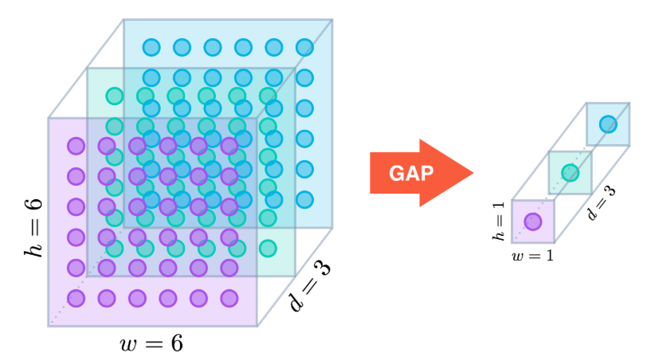
Model Implementation (Model Construction)
The model construction includes following steps:
We initialized InceptionV3 model as our base model. The parameters trained on ImageNet dataset.
[The complete documentation on Inception V3 model is available at : https://keras.io/applications/ ]
2. Then we added a Global Average Pooling(GAP) layer to the model to reduce the spatial dimensions of a three dimensional tensors, which eventually minimizes overfitting by reducing the number of parameters. It reduces h * w * d dimensions to 1 *1 * d dimensions by taking the average of h and w values.
(GAP Details available: https://alexisbcook.github.io/2017/global-average-pooling-layers-for-object-localization/)
We added a fully connected layer of 1024 hidden nodes. Finally, the FC layer is connected to our output layer to predict output. The FC mainly takes the output from GAP as input and provides output to our final output layer to predicts the best label to describes the images. Since the number of output classes are more than two we have kept ‘Softmax’ as the activation function.

Slide 36
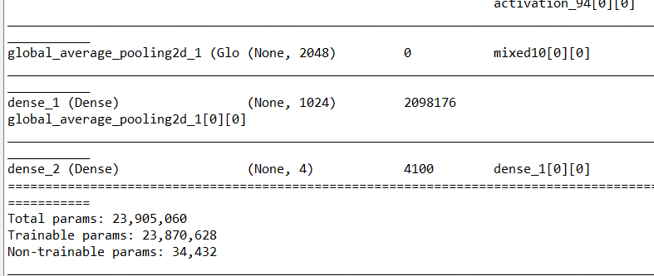
Model Implementation (Model Construction)
Summary of constructed model :
Total Number of Layers: 314.
Non-trainable Layers: 249
Trainable Layers: 65
A portion of generated summary:

Slide 37
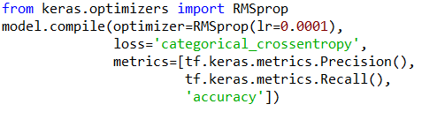
Model Implementation (Model Compilation)
We have used following parameters for compiling the method:
Optimization Algorithm
RMSprop
Learning Rate: 0.0001
Loss Function
Categorical Cross-Entropy
Performance Evaluation Metrics
Precision
Recall
Accuracy

Slide 38
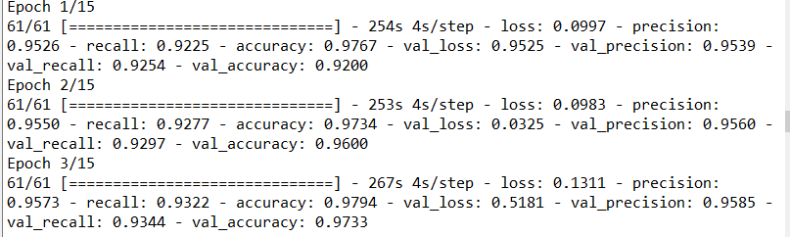
Model Implementation (Train and Validation)
We trained and validated the model using following parameters:
Train:
Dataset: Train Dataset
Validation:
Dataset: Validation Dataset
Epochs:
Maximum No of Epochs: 15
Regularization:
Early Stopping

Slide 39
Methodology (Performance Evaluation)
Accuracy: 95%
Precision: 0.91
Recall: 0.85
Dataset: Test Dataset

Slide 40
Result Analysis
In this project, we use the Inception V3 model. And, we get the highest test accuracy of 95.33%.
Epoch | Loss | Precision | Recall | Accuracy | Val_Loss | Val_Precision | Val_Recall | Val_Accuracy
1 | 0.3098 | 0.8848 | 0.7687 | 0.8983 | 0.2555 | 0.8931 | 0.7961 | 0.9200
2 | 0.3321 | 0.8952 | 0.8044 | 0.8937 | 0.1318 | 0.8970 | 0.8157 | 0.9067
3 | 0.2737 | 0.9000 | 0.8253 | 0.9116 | 0.7863 | 0.9025 | 0.8342 | 0.9133
4 | 0.2282 | 0.9056 | 0.8418 | 0.9336 | 0.2996 | 0.9090 | 0.8496 | 0.9200

Slide 41
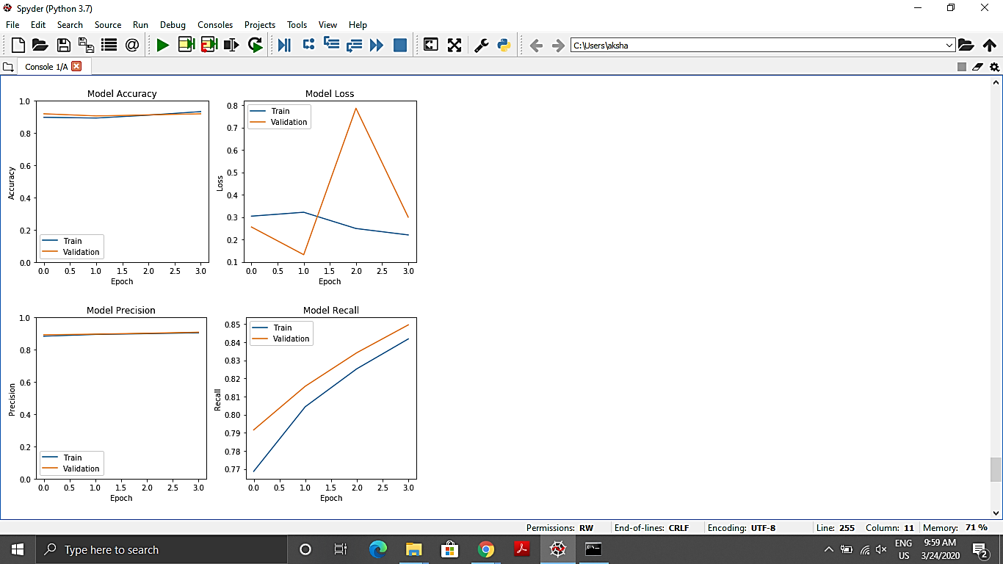
Test Loss – 0.02
Test Precision – 0.91
Test Recall – 0.85
Test Accuracy – 95.33

Slide 42
Test Result With Different Optimizer
Optimizer | Total Epoch | Test Loss | Test Precision | Test Recall | Test Accuracy
RMSprop | 4 | 0.02 | 0.91 | 0.85 | 95.33
SGD | 6 | 0.07 | 0.95 | 0.94 | 92.67
Adam | 6 | 0.04 | 0.95 | 0.94 | 93.33

Slide 43
Test Result Without Image Augmentation
Optimizer | Total Epoch | Test Loss | Test Precision | Test Recall | Test Accuracy
RMSprop | 8 | 4.05 | 0.91 | 0.73 | 75.33
SGD | 5 | 0.15 | 0.87 | 0.82 | 78.67
Adam | 5 | 0.28 | 0.94 | 0.88 | 90.00

Slide 44
Final Result
After performing an operation on different test cases, we found that
For the small dataset, Image Augmentation can increase the accuracy
In our application, the performance of RMSprop optimizer is higher then SGD and adam.
With the help of default Inception V3, we achieve 95.33% accuracy.

Slide 45
Conclusion
Our primary goal is to create Canadian Medicinal Plant classification.
We used the Inception V3 model with transfer learning and image augmentation.
In dense layer, we used relu as a activation function.
We also used the early stopping regularization with patience = 3.
We achieved 95.33% accuracy.
In our application, we found that the performance of RMSprop optimizer is better then SGD and Adam.

Slide 46
Future Work
Increase the size and quality of our dataset.
Try to implement this application on some new model like Inception V4, Inception Resnet.

Slide 47
References
Agarwal, G., Belhumeur, P., Feiner, S., Jacobs, D., Kress, W.J., Ramamoorthi, R., Bourg, N.A., Dixit, N., Ling, H., Mahajan, D., et al., 2006. First steps toward an electronic field guide for plants. Taxon 55 (3), 597–610.
Barré, P., Stöver, B.C., Müller, K.F., Steinhage, V., 2017. Leafnet: a computer vision system for automatic plant species identification. Ecol. Informat. 40, 50–56.
Gerhards, R., Christensen, S., 2003. Real-time weed detection, decision making and patch spraying in maize, sugarbeet, winter wheat and winter barley. Weed Res. 43 (6), 385–392.
Grinblat, G.L., Uzal, L.C., Larese, M.G., Granitto, P.M., 2016. Deep learning for plant identification using vein morphological patterns. Comput. Electron. Agric. 127, 418–424.
Husin, Z., Shakaff, A., Aziz, A., Farook, R., Jaafar, M., Hashim, U., Harun, A., 2012. Embedded portable device for herb leaves recognition using image processing techniques and neural network algorithm. Comput. Electron. Agric. 89, 18–29.
Jeon, W.-S., Rhee, S.-Y., 2017. Plant leaf recognition using a convolution neural network. Int. J. Fuzzy Logic Intell. Syst. 17 (1), 26–34.
Ji, S., Zhang, C., Xu, A., Shi, Y., & Duan, Y. (2018). 3D convolutional neural networks for crop classification with multi-temporal remote sensing images. Remote Sensing, 10(1), 75.

Slide 48
References
Kaya, A., Keceli, A. S., Catal, C., Yalic, H. Y., Temucin, H., & Tekinerdogan, B. (2019). Analysis of transfer learning for deep neural network based plant classification models. Computers and electronics in agriculture, 158, 20-29.
Larese, M.G., Namías, R., Craviotto, R.M., Arango, M.R., Gallo, C., Granitto, P.M., 2014. Automatic classification of legumes using leaf vein image features. Pattern Recogn. 47 (1), 158–168.
Larese, M.G., Baya, A.E., Craviotto, R.M., Arango, M.R., Gallo, C., Granitto, P.M., 2014. Multiscale recognition of legume varieties based on leaf venation images. Expert Syst. Appl. 41 (10), 4638–4647.
Lee, S.H., Chan, C.S., Mayo, S.J., Remagnino, P., 2017. How deep learning extracts and learns leaf features for plant classification. Pattern Recogn. 71, 1–13.
Neto, J.C., Meyer, G.E., Jones, D.D., Samal, A.K., 2006. Plant species identification using elliptic fourier leaf shape analysis. Comput. Electron. Agric. 50 (2), 121–134.
Sack, L., Dietrich, E.M., Streeter, C.M., Sánchez-Gómez, D., Holbrook, N.M., 2008. Leaf palmate venation and vascular redundancy confer tolerance of hydraulic disruption. Proc. Nat. Acad. Sci. 105 (5), 1567–1572.
Scoffoni, C., Rawls, M., McKown, A., Cochard, H., Sack, L., 2011. Decline of leaf hydraulic conductance with dehydration: relationship to leaf size and venation architecture. Plant Physiol. 156 (2), 832–843.
Woebbecke, D.M., Meyer, G.E., Von Bargen, K., Mortensen, D., 1995. Color indices for weed identification under various soil, residue, and lighting conditions. Trans. ASAE 38 (1), 259–269.

Slide 49



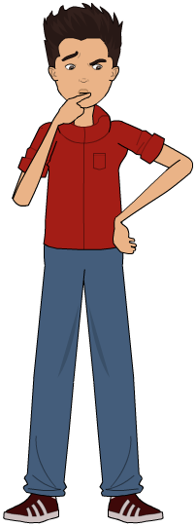


Slide 50


